Slide 1
Mental Health for Teens
Adapted from TeenMentalHealth

Slide 2
Mental Health is all States
Click here to watch a video explaining mental health states.
https://www.youtube.com/watch?v=LsowyMnqCRs
You can flow back and forth between states and exist in more than one state at a time.

Slide 3
Mental Health Problem
•The brain’s response to a severe or persistent life problem (e.g. death of a family member, severe bullying, parent divorce)
• Happens to everyone many times in their life
• Shows that adaptation is difficult
• May require additional help (such as a counsellor or therapist)
• Does not require treatment

Slide 4
Mental Distress
The brain’s expected and usual response to the stresses of everyday life (e.g. exams, relationships, disappointments)
Happens to everyone every day
Leads to adaptation, learning and coping
Is often seen as negative instead of as helpful
Must reframe as positive (excitement not stress) • Does not need treatment

Slide 5
Mental Health Disorder
The brain is not functioning as it is supposed to function, leading to significant and persistent problems in a person’s everyday life (caused by a combination of genetic and environmental factors)
A mental illness affects a person’s thinking, feelings or behavior (or all three) and causes that person difficulty in functioning
Happens to about 20% of people over their lifetime
Must be diagnosed by a properly trained health professional
Requires scientifically valid treatments provided by a trained health professional

Slide 6
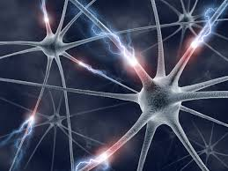
What happens when the brain gets sick
When the brain gets sick a specific part of the brain may not be working well or may be working in the wrong way
Or when a brain network is disrupted and the communication pathways between different parts of the brain are not working properly

Slide 7
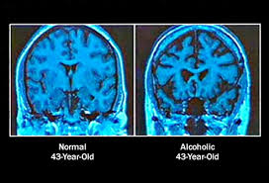
What can cause this?
z
Genetics
Injury to the brain (such as concussion)
Infection of the brain
Tumor of the brain
Effect of severe and persistent stress
Toxins from the environment – such as drugs

Slide 8
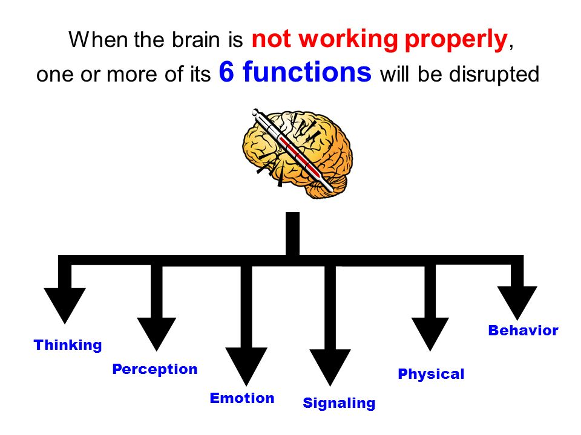
A healthy lifestyle is good for brain development
z

Slide 9
Stigma
Stigma refers to “a cluster of negative attitudes and beliefs that motivate the general public to fear, reject, avoid and discriminate against people with mental illness. Stigma is not just a matter of using the wrong word or action. Stigma is about disrespect. It is the use of negative labels to identify a person living with mental illness. Stigma is a barrier. Fear of stigma and the resulting discrimination discourages individuals and their families from getting the help they need.” (SAMHSA, 2004)
One way to help decrease stigma is to challenge myths with data and with scientific knowledge

Slide 10
Mental Illness and Teens
About 70% of all mental illnesses can be diagnosed before 25 years of age
When they start, most mental illnesses are mild or moderate and respond well to proper treatments
Knowing about mental illnesses is essential for getting help early
Knowing about treatments for mental illnesses is important so you can be well informed if help is needed
z

Slide 11
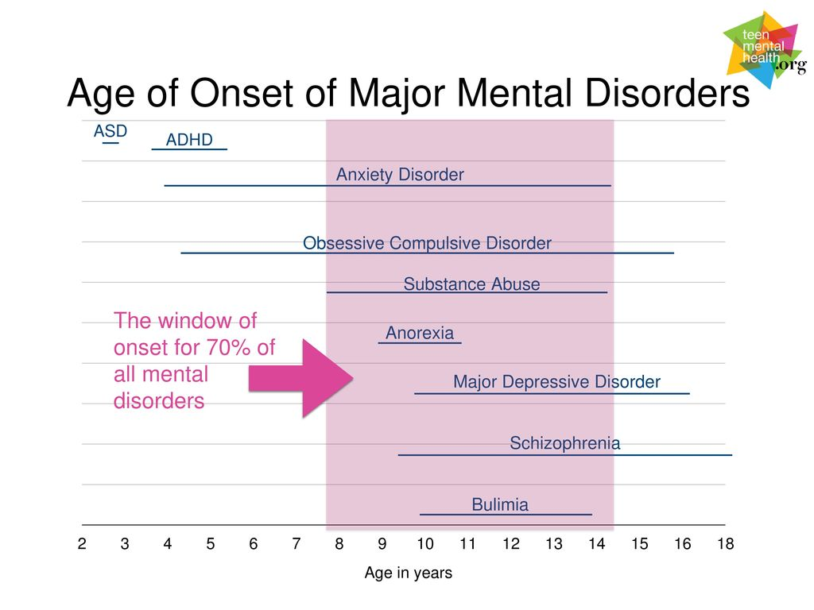

Slide 12
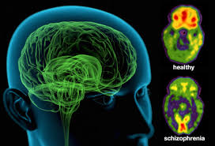
Disturbances in Cognition and Perception
Psychosis Schizophrenia

Slide 13
Psychosis
z
A psychosis is a disturbance of brain functioning involving cognition and perception.
For example: delusions (fixed false beliefs, a cognition) and hallucinations (perceptions occur without a stimulus, such as hearing voices when nobody is speaking)
A common psychosis beginning during adolescence is Schizophrenia

Slide 14
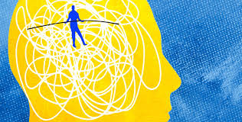
Schizophrenia
z
Schizophrenia is characterized by
Delusions • Hallucinations • Disorganized thinking • Disorganized behavior • Disturbances in motivation • Difficulties in many parts of life
Affects about 1% of the population
Males and females equally
Usually is diagnosed between 15 and 25 years of age
With early diagnosis and use of effective treatments many people with Schizophrenia recover
https://www.youtube.com/watch?v=pcKyyQvCFtM
Click to watch a short video

Slide 15
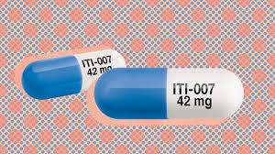
Treatments for Schizophrenia
z
People with Schizophrenia are treated with medications (called antipsychotics) and various psychological therapies
Often additional kinds of treatments such as vocational therapy and social therapies are also used
People with a severe form of Schizophrenia may also receive help with housing and community supports

Slide 16
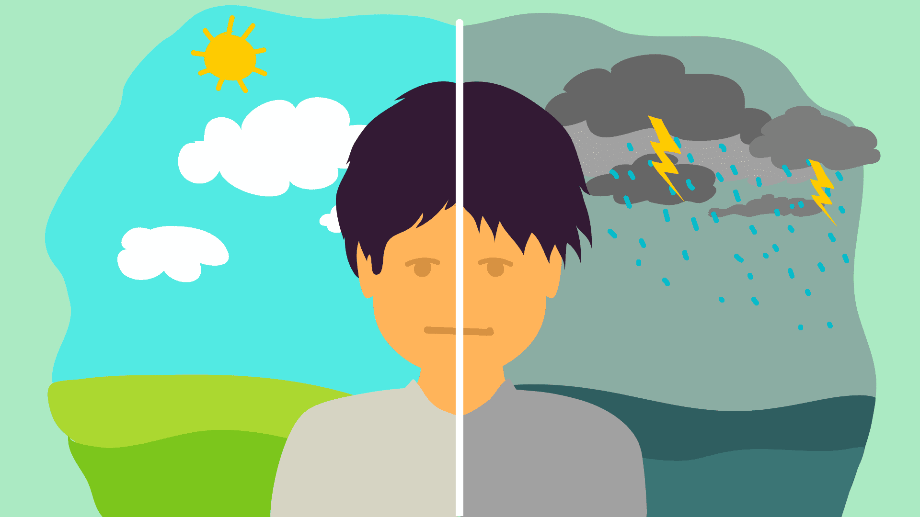
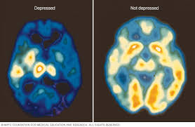
Disturbances in Emotions
Mood Disorders:
Major Depressive Disorder
Bipolar Disorder

Slide 17
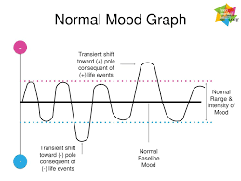
Mood Graph
z

Slide 18
Depression
z
Depression is not the same as feeling depressed
Depression is characterized by persistent and sustained: depressed mood, loss of interest, guilty ruminations, feelings of hopelessness/worthlessness, fatigue, concentration problems, loss of appetite, loss of pleasure, suicidal thoughts/actions
Depression leads to many problems in everyday life and affects about 4-6% of teens
https://www.youtube.com/watch?v=i8EPzkxAiVw
Click to watch a short video​

Slide 19
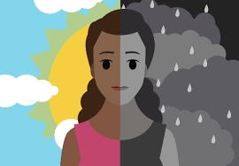
Bipolar Disorder
z
Bipolar Disorder includes both Manic and Depressive episodes and affects about 1% of the population
Depressive episodes are similar to Depression
Manic episodes include: lack of sleep, excessive activity, rapid racing thoughts, poor judgement, frequent high risk behaviors, poor concentration, delusions
People with Bipolar Disorder will swing from one type of episode to another – sometimes over the course of days or over periods of years: in between episodes moods can be relatively stable
Click to watch a short video​
https://www.youtube.com/watch?time_continue=3&v=iDEE_54zobU

Slide 20
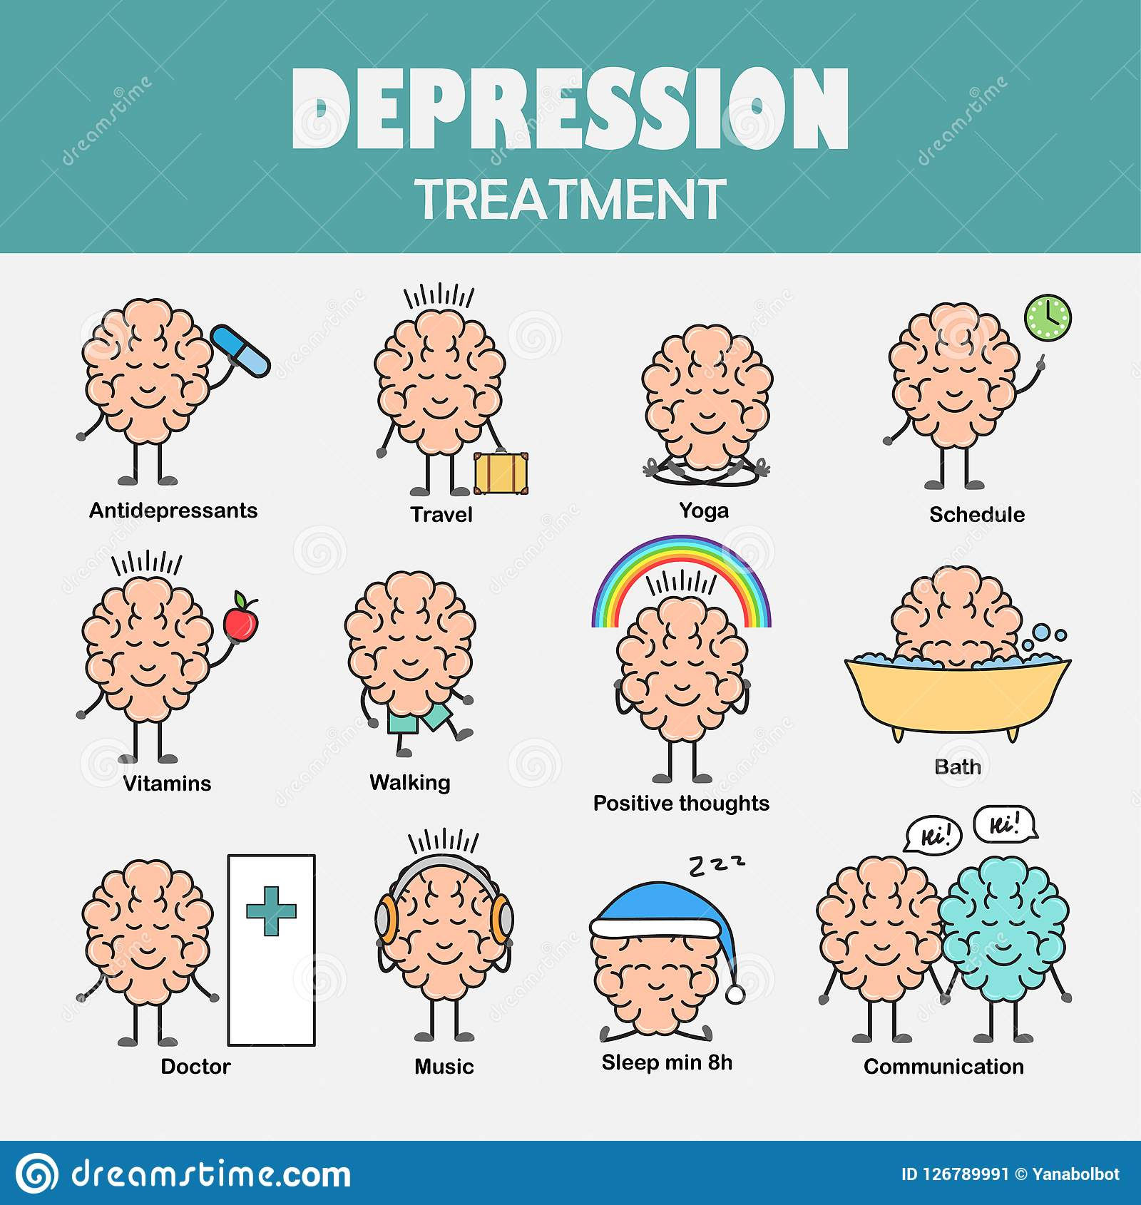
Treatments for Mood Disorders
z
Effective treatments for mood disorders are available
For Depression, a combination of a psychotherapy (usually Cognitive Behavior Therapy: CBT) and an antidepressant medication (usually an SSRI) is used
For Bipolar Disorder medications (such as lithium or other medications), psychotherapy and other treatments are used

Slide 21
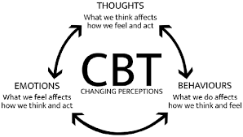
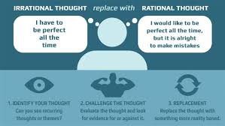
Cognitive Behavioural Therapy (CBT)
z

Slide 22
Disorders of Signaling
z
Anxiety
Social Anxiety Disorder
Panic Disorder
Obsessive Compulsive Disorder
Post-Traumatic Stress Disorder

Slide 23
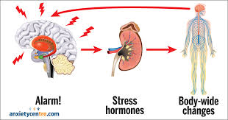
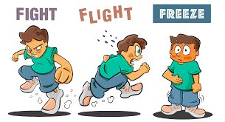
The Signaling Response

Slide 24
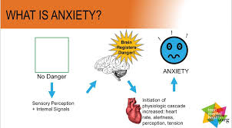

Slide 25
Social Anxiety Disorder
z
People who have SAD experience severe fear/high anxiety in social situations
They think that they are being closely watched, judged or criticized by others
They think they will be embarrassed or humiliated • As a result, they avoid social situations (speaking in class, going to a party, etc.)
Sometimes they can experience a panic attack but only in a social situation
https://www.youtube.com/watch?v=kitHQUWrA7s
Click to watch a short video​

Slide 26
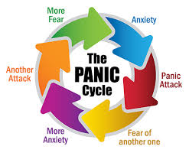
Panic Disorder
z
People who have PD experience frequent panic attacks that just “come out of the blue”
They also develop anxiety about having an attack
And, they avoid going to places where they think they may experience an attack
Sometimes the avoidance can become so strong the person mostly stays at home. This is called Agoraphobia.
https://www.youtube.com/watch?v=R3S_XYaEPUs
Click to watch a short video​

Slide 27
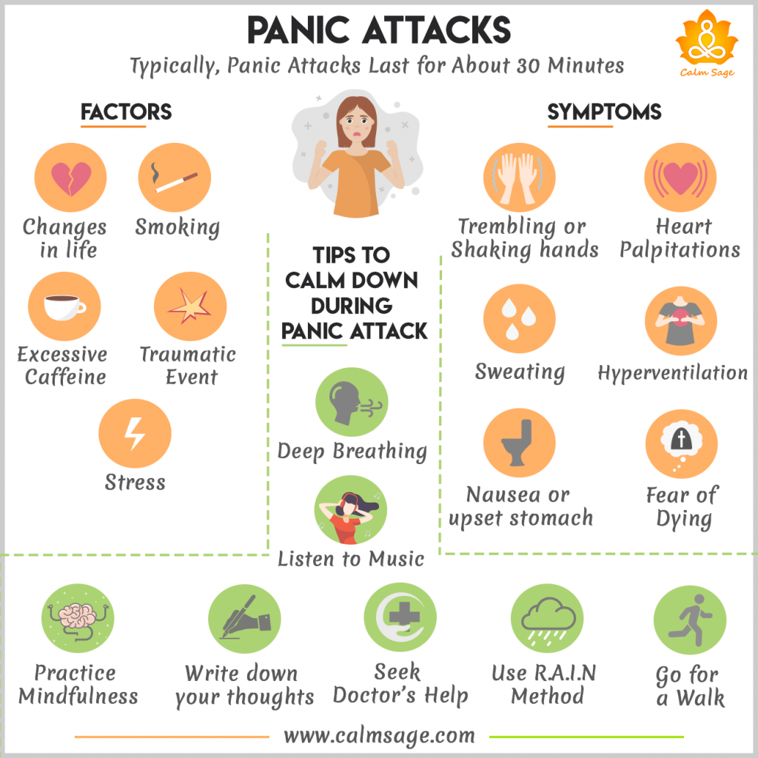
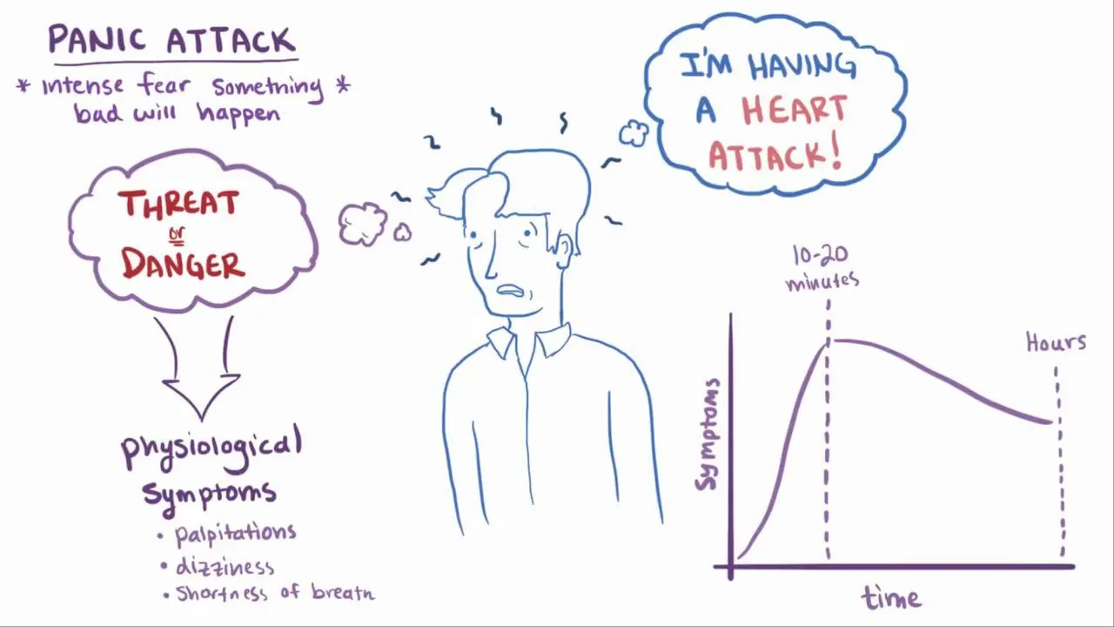

Slide 28
Obsessive Compulsive Disorder (OCD)
OCD has two components: obsessions and compulsions
Obsessions are severe, recurrent, persistent thoughts that a person knows are not true but cannot stop
Common obsessions include: germs/dirt, thoughts that something terrible will happen, unwanted sexual or religious thoughts, etc.
Compulsions are repetitive actions that the person does to try and decrease their discomfort from having compulsions
Common compulsions include: washing, brushing, counting, tapping, chanting, putting objects into specific order, etc.
Obsessions and compulsions seem to run a person’s life
z
https://www.youtube.com/watch?v=ua9zr16jC1M
Click to watch a short video​

Slide 29
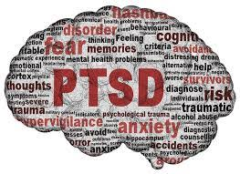
Post Traumatic Stress Disorder (PTSD)
z
After a severe traumatic event (e.g. witness to murder, rape, automobile accident, etc.) everyone will experience significant distress and many symptoms (e.g. trouble sleeping, flashbacks about the event, feeling worried/restless,etc.)
This is normal, it’s called the Acute Stress Response, and will usually go away gradually over about 4-6 weeks
PTSD is the persistence of severe symptoms of: re-experiencing the event, hyper arousal (trouble sleeping, excessive worry/restlessness), avoidance of things that remind of the event, numerous negative emotions and thoughts
These symptoms cause significant problems in daily living

Slide 30
Treatment for Signaling Disorders
z
Effective treatments for Anxiety Disorders are available
Usually a psychological therapy called Cognitive Behavioral Therapy (CBT) is used
Sometimes a medication is also used in addition to the CBT
https://www.anxietycanada.com/

Slide 31
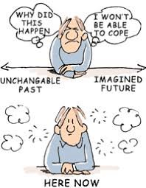
Mindfulness
z
The scientific power of meditation​
https://www.youtube.com/watch?v=Aw71zanwMnY​

Slide 32
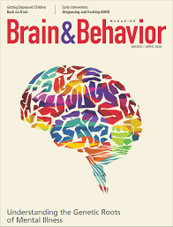
Disorders of Behavior
Attention Deficit Hyperactivity Disorder (ADHD)
Eating Disorders (Anorexia Nervosa and Bulimia Nervosa)
Substance Use Disorder (Addiction)

Slide 33
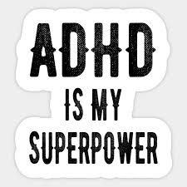
Attention Deficit Hyperactive Disorder (ADHD)
People who have ADHD are usually diagnosed in primary school but the ADHD continues into secondary school and often beyond
Symptoms fall into the categories of: Hyperactivity (constant movement), Impulsivity (doing things without thinking), and Attention (trouble keeping focused in a sustained way)
These symptoms lead to problems at school, home and other parts of life
Effective treatments are available and include medications and some behavior/self-monitoring therapies
z
https://www.youtube.com/watch?time_continue=34&v=leLF0FnHFUk
Click to watch a short video​

Slide 34
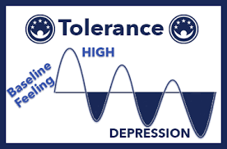
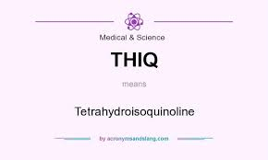
Substance Abuse Disorder
z
This diagnosis is commonly referred to as Addiction
This means using a substance to the point that it causes harm to the person or those around him/her
Craving for the substance (the inner drive to use the substance) drives the behaviors
Effective treatments are available and include psychological as well as medications (for some kinds of addiction)
Click to watch a short video​
https://www.youtube.com/watch?v=T5sOh4gKPIg

Slide 35
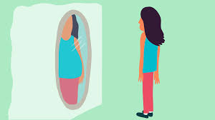
Eating Disorders
z
Anorexia Nervosa (AN) is severe weight loss caused by a person self-starving because they incorrectly think and feel that they are too fat
Bulimia Nervosa (BN) is the binge eating of large amounts of food in a very short period of time followed by self-induced vomiting
Effective treatments for AN are available and include various psychotherapies and hospitalization if starvation is causing physical health concerns
Effective treatments for BN are available and include various psychotherapies and medications
https://www.youtube.com/watch?time_continue=36&v=Ymqo4u-Sh_k
Click to watch a short video​

Slide 36
Suicide
z
Suicide is not a mental disorder
Suicide attempts are not an expected response to life stresses
Suicide is most often an unfortunate outcome of a mental disorder that is often not recognized or is not treated effectively •Suicide that happens during the teenage years is often the result of Depression
Most people who attempt suicide never die from suicide because effective treatments are available
The presence of suicidal thoughts is a signal that a person needs help from a trained mental health provider
If you or someone you know is having suicidal thoughts speak to a trusted adult and go to see a health professional who can help you get the care you need

Slide 37
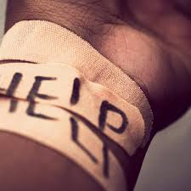
Self Harm
z
Self-harming is a behavior that some people use to try and help them solve a problem
It is not a useful method of problem solving and can itself become more of a problem than what it was supposed to help •
Some people experience social pressure to self-harm – this is also not helpful
If you or a person you know is self-harming, this is a signal that better ways to solve problems are needed – speak to a trusted adult and find out where you can get help

Slide 38
What Can I do
z
If I think I may have a mental illness, feel suicidal or am self-harming, I should talk to a trusted adult and get help from a health professional
If I think that a friend or family member may have a mental illness, is suicidal or is self-harming, I should go with them to talk to a trusted adult and encourage them to get help from a health professional
HELP IS AVAILABLE
Text 686868
Kid's Help Phone at 1-800-668-6868

Slide 39
Check out these helpful mental health websites
https://cmha.ca/
https://foundrybc.ca/terrace/
https://keltymentalhealth.ca/
https://www.heretohelp.bc.ca/

