Slide 1
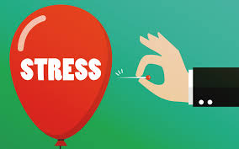
Tools for Managing Stress

Slide 2
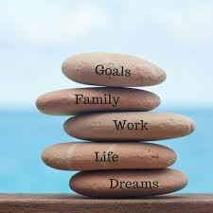
What have you done this month to bring balance to your life?

Slide 3
Types of Stress
Day-to-Day | Cumulative/Distress | Extreme/Traumatic | Vicarious/Secondary
Getting to school on time Bad weather Job interview Deadline to complete a project | Being able to pay rent Working long hours over a period of time Hurtful relationships | Death of a loved one Car accident (experienced or witnessed) Sexual assault Natural disaster | Hearing stories of serious loss Supporting people who are experiencing traumatic stress Over exposure to violent or upsetting stories in the media

Slide 4
MENTAL HEALTH AND WELLNESS IN THE WORKPLACE
High work demands, stress, lack of resources, bullying, and limited supports in the work environment are some of the factors that can increase the risks of workplace mental health struggles (diagnosed or undiagnosed). Mental health and safety struggles at work are just as important as physical health and safety.
“Mental health is knowing and accepting yourself, understanding what makes you happy, building meaningful relationships, coping with problems of day-to-day living and maintaining a sense of humour.” (CMHA, 2019)
After reading the definition of mental health and wellness presented above what key words or phrases resonate with you?

Slide 5
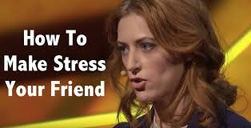
by Kelly McGonigal
This TED talk challenges you to think about stress differently.
https://www.youtube.com/watch?v=RcGyVTAoXEU

Slide 6
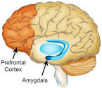
Neurons that fire together, wire together.

Slide 7
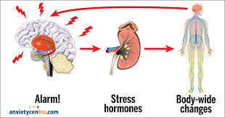
The Stress Response
Amygdala
Detects threats
Flight, flight or freeze
Stress hormones
Keeps you safe
Intense emotions
Defensive, fear-based
Stores memories of events
The Prefrontal Cortex
Regulates emotion
Calms fear
Self-control
Empathy
Planning and goals
Decision –making
Problem solving – seeing choices

Slide 8
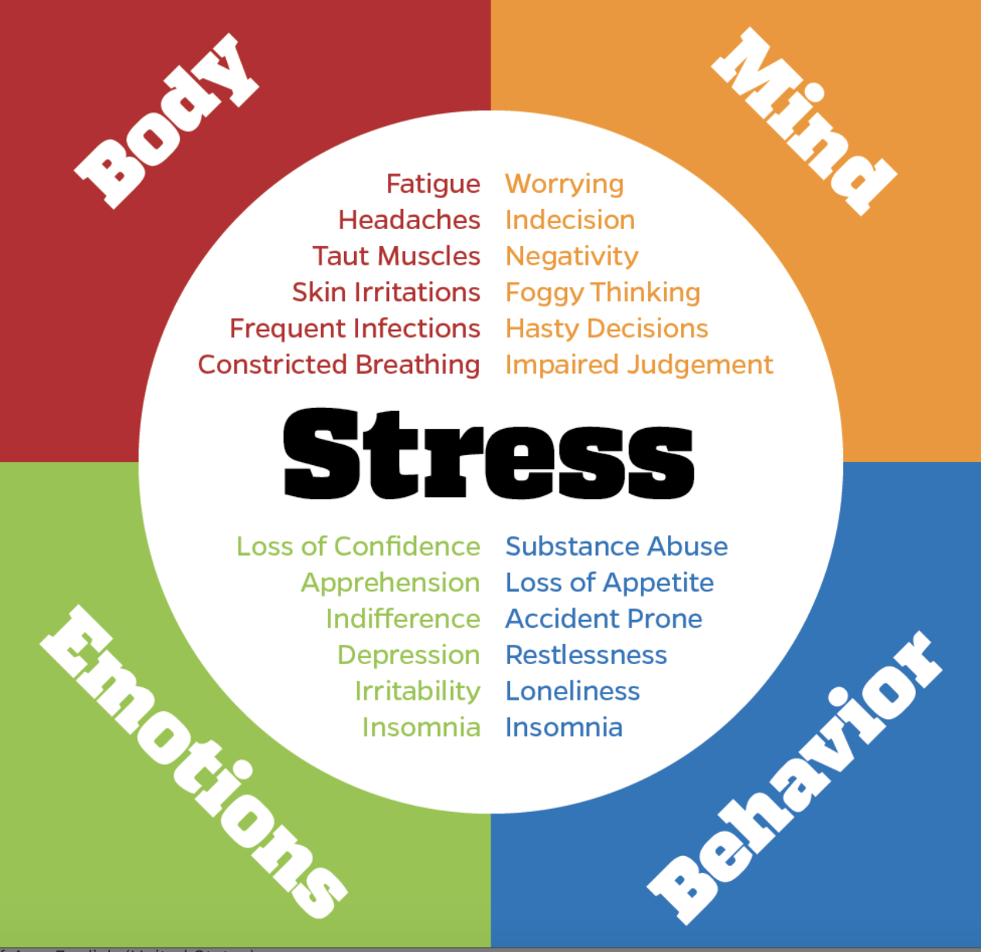
Common Signs of Stress

Slide 9
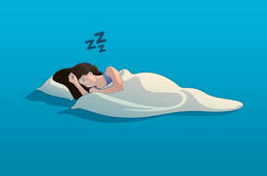
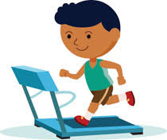
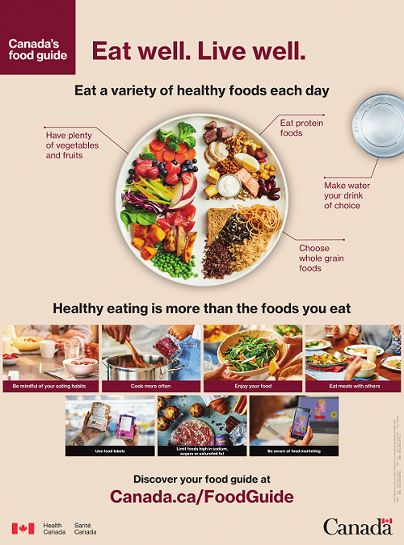
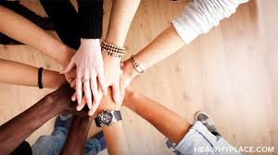
S.E.E.C.
Good Mental Health
​
S- Sleep​
E- Exercise​
E- Eat​ Well
C- Connections (to others, culture, environment and creativity)
These are the pillars of good mental health. It is wise to incorporate them into your everyday life. Practice good mental health even when you are feeling good. Discuss ways of meeting these needs. Try something new to change your situation.

Slide 10
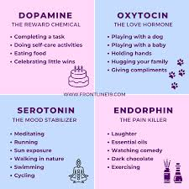
Get your daily D.O.S.E. of happiness chemicals!

Slide 11
Click on link to poster with many strategies for dealing with stress. You may want to print for future use.
https://sd52-my.sharepoint.com/:b:/g/personal/pgroves_sd52_bc_ca/EbdylTj4951PsOvIp7fSJlcBo2Wh4Rzr6AIu_KfdBLTWPw?e=E3PWEc

Slide 12
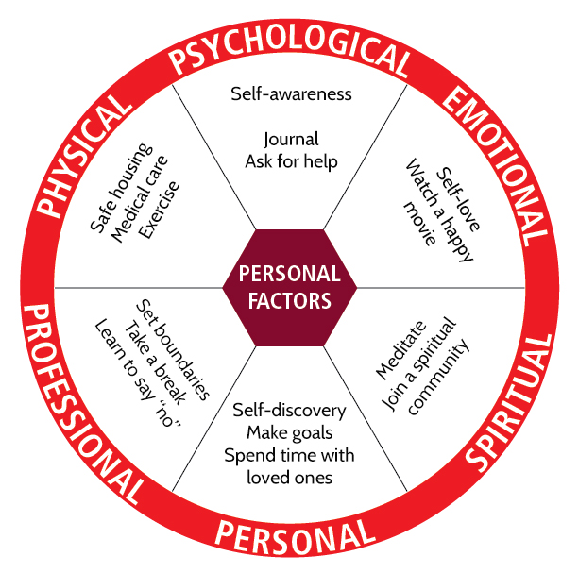
What strategies do you use that work? What new strategy could you try?

Slide 13
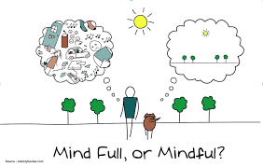
Relaxation/Mindfulness
Why mindfulness is a super power?
https://www.youtube.com/watch?v=w6T02g5hnT4
The scientific power of meditation
https://www.youtube.com/watch?v=Aw71zanwMnY
Tips
You can do it wrong – no judging!
Any posture or place works.
Just notice the here and now.
Build in when living is easy, so you can recall in times of stress.

Slide 14
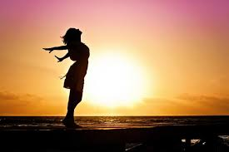
PROGRESSIVE BODY RELAXATION
https://www.youtube.com/watch?v=8Xp2UzG7UYY
Click on the link and try one example of mindfulness

Slide 15
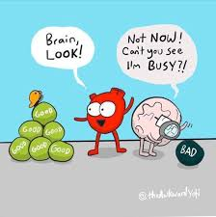
The Negativity Bias
“Your brain is like Velcro for negative experiences,
but like Teflon for positive experiences”
Grey Experiment
Gratitude Mindfulness
Notice 3 things that you feel grateful for, feel good about, going well.
Can be a person, location, activity, quality, object, pet or food.
Stay with it. Notice it. Savour it.
Daily practise. Set an intention to notice the good “stuff” in life.

Slide 16
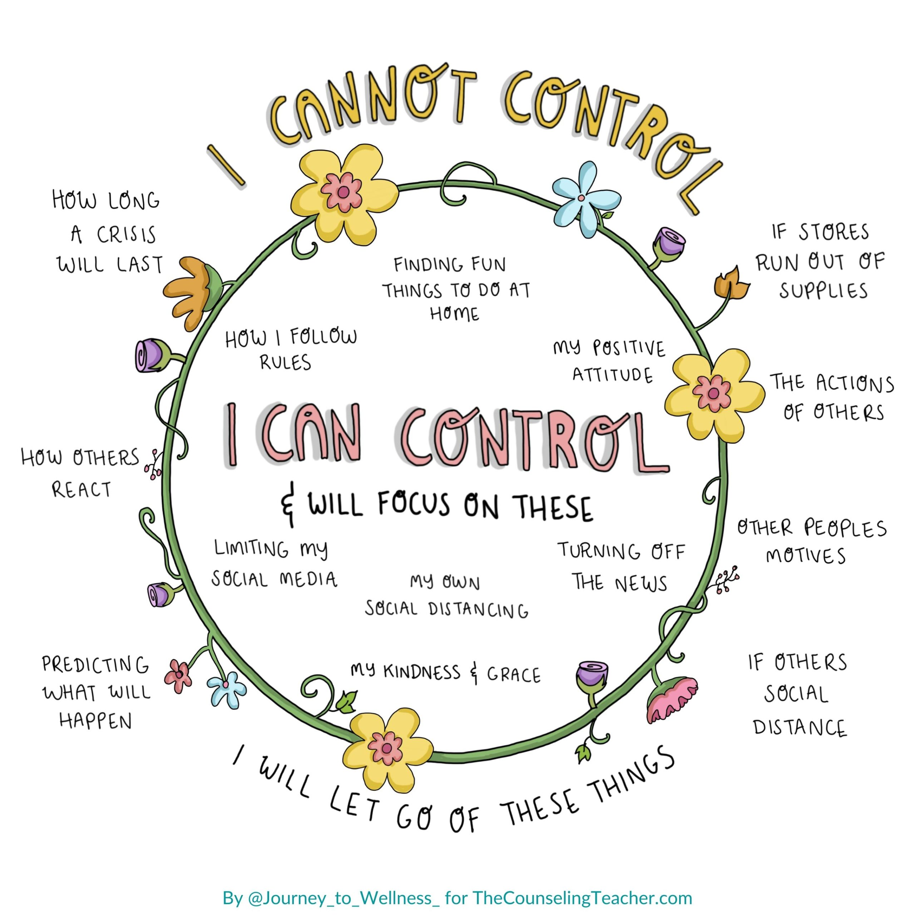
Focus on what you can control

Slide 17
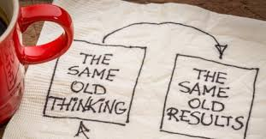
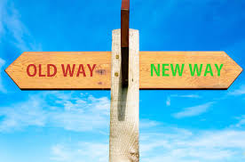
Challenge Thoughts
Notice it.
Is it realistic?
Is it kind?
Is it helpful?
Get evidence.
Replace thinking.

Slide 18
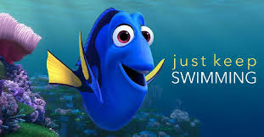
Practice Positive Affirmations
Think of a saying or a mantra that you can repeat to yourself in times of high stress.
Some examples:
One day at a time
This too shall pass
Ive got this

Slide 19
Fewer Things, Better by Angela Watson
Great book written by a teacher for teachers.. Counselling department has a copy you can borrow.

Slide 20
Be kind to yourself and seek help if your stress is overwhelming.
Check out this link to bctf resources:
https://bctf.ca/wellness/

